Slide 1
Project 4 – Machine Learning
Trevor Baum & Nick carson

Slide 2
Store Sales Overview
Dataset- The data is from a grocery store chain and contains these attributes:
Store #, Store Sales, Sq. Yd., # of items available, and daily customer count
Goal – Leverage machine learning to predict store sales based on the features of the data set.
Setup –
Add more data points based on existing data
Clustered stores to see the variations between stores
Get a better understanding of the data
Scaled and split the data
Test different machine learning models
https://www.kaggle.com/datasets/surajjha101/stores-area-and-sales-data

Slide 3
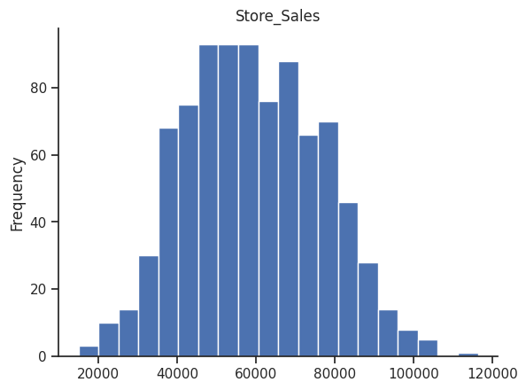
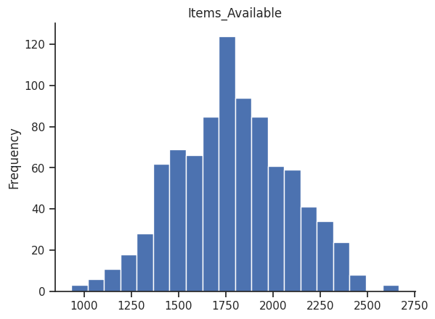
Dataset distribution

Slide 4
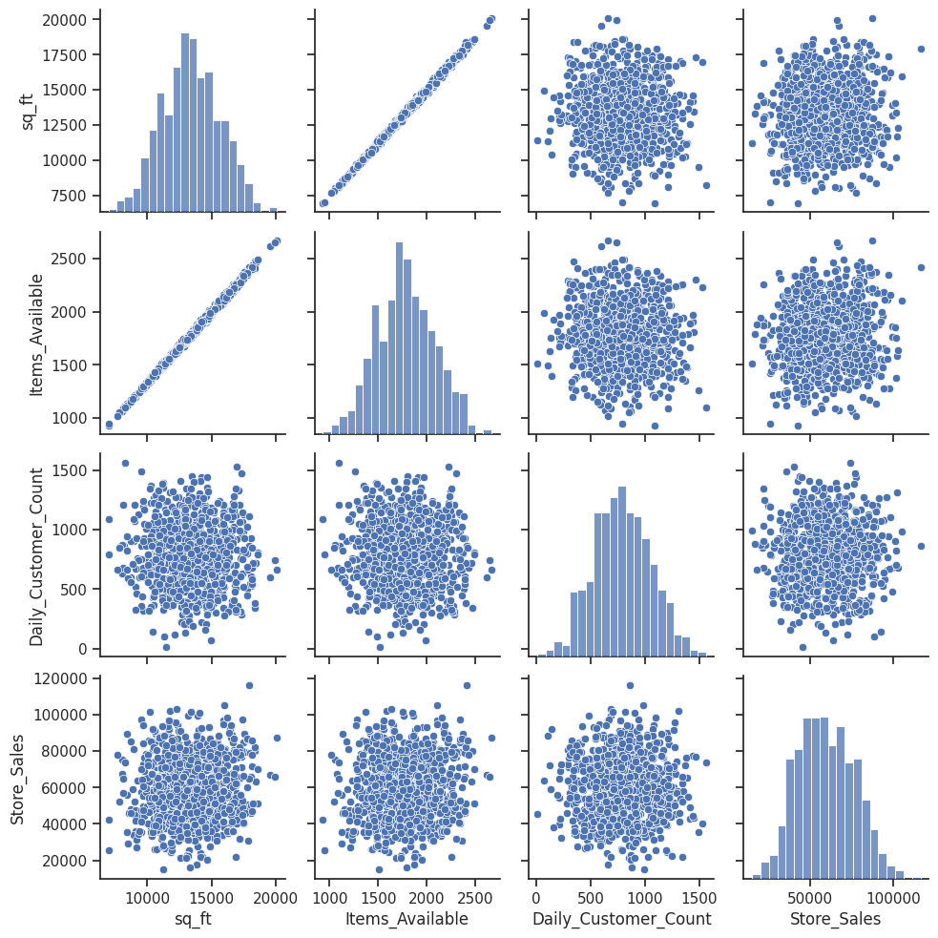
Correlation Summary
There was a strong linear correlation between items available and sq. ft
There was a normal distribution correlation between sq ft and the other 4 metrics.
The rest of the variables didn’t have a strong correlation.
Notes:
As you can see from the correlation scatter plots, there were only two variables that had any substantial correlation. These were Items available and store square footage.

Slide 5
Results of 4 Models
Model | RScore | MSE | RMSE | Notes
Linear Regression | -.003 | 304,705,256 | 17,455
Random Forest | -.195 | 363,058,547 | 17,455
XGBoost | -.37 | 416,711,504 | 20,413 | Random state 116
KNN | -1.04 | 620,094,377 | 24,901 | Ran w/ 100 Epoch using relu, and linear models

Slide 6
Conclusion
We tried feature engineering and reviewing data from a correlation perspective, and there wasn’t a strong correlation between any of the metrics.
Modeled the coefficient to determine which features had the most significance.
Items Available and customer per sq ft were the most important
The rest of the features were negative.
Need more data points with correlation and importance to improve accuracy score.
"All models are wrong; some are useful“ – George E.P. Box
Notes:
If we had better data along with more important features, we would still need to run multiple model and do a weight summation of all of them to get to an high accuracy score.

